Slide 1

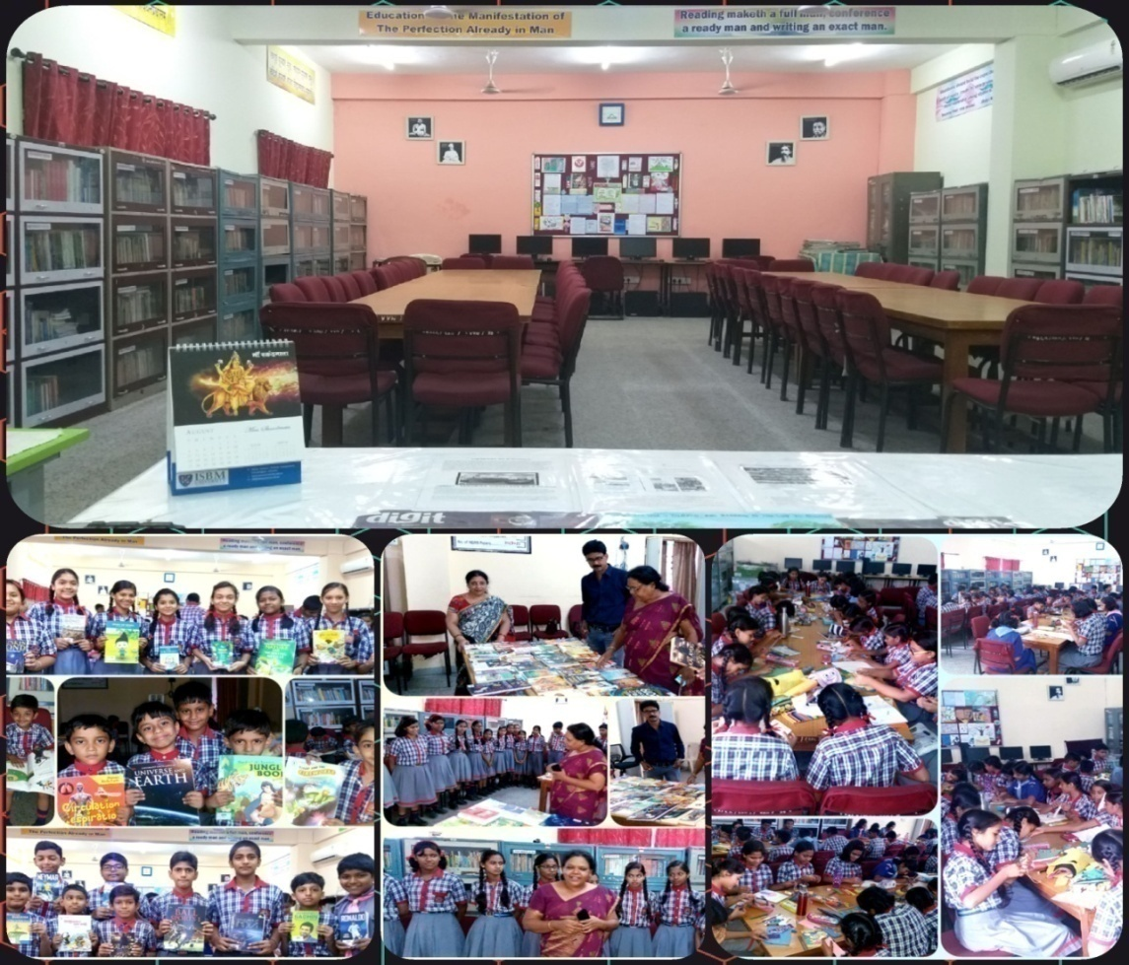





School Library

Slide 2
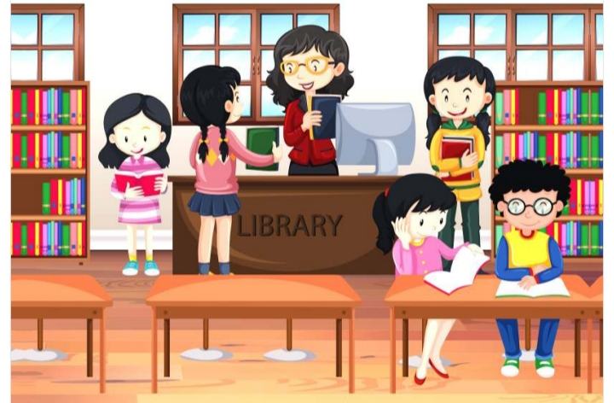
The School libraries are considered as the nerve centres of knowledge which serve the students and staff members with needed information resources and act as vital partners in the collaborative learning activities.
The goal of the school library media center is to ensure that all members of the school community have equitable access "to books and reading, to information, and to information technology.

Slide 3

Objectives of the School Library
Supporting and enhancing educational goals of School.
Be the knowledge hub of the school and disseminate knowledge as widely as possible.
Provide a curriculum-based, flexibly scheduled, open access learning environment that accommodates all learners.
Facilitate creation of new knowledge.
Facilitate optimal use of knowledge by all staff and students.

Slide 4


Encourage and foster reading habit among staff and students.
Effectively participate in the teaching-learning programmes of the school.
To provide intellectual access to information through learning activities that are integrated into the curriculum and that help all students achieve information literacy

Slide 5
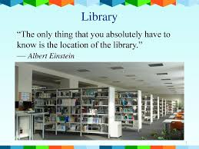
Location of the Library
The library should be located strategically and have adequate space to accommodate all its resources, users and activities. When new library buildings are designed and the existing ones are restructured, the following factors should be considered.

Slide 6
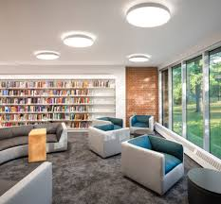
Central location, on the ground floor if possible
Accessibility and proximity, being close to all teaching areas
Noise factors, with at least some parts of the library free from external noise
Appropriate and sufficient light, both through windows and artificial light

Slide 7

Wall and furniture shall be painted with attractive, non-reflective and eye/reading friendly shades
Aesthetically designed wall fixtures, imageries and potted plants
Provision for maintaining appropriate room temperature (e.g. air-conditioning, heating) to ensure good working conditions all around the year as well as the preservation of the collections
Appropriate design to meet the special needs of differently abled library users.

Slide 8
The Library should have adequate space for keeping the books, periodicals, newspapers, multimedia and other resources arranged as per the prescribed classification system. There shall be a reading room, teacher’s corner, space for group activities, staff work areas and a librarian’s room. Spaces for computer workstations, displays (shelves/tables/stands), property counter, and a library circulation counter are also essential.

Slide 9
Size and Seating Capacity
The size and seating capacity of the Reading Room will depend on the optimum number of students that a school usually admits. There should be space for at least 50 students from a class at a time and / or 10-30 students and or teachers who come for other group activities, projects, reading, internet browsing, and reference. (i.e., the reading room should have a capacity of seating 50 to 80 persons at a time). A provision of 10 sq.ft floor area per pupil in Reading Room is considered adequate.

Slide 10

The stack room should be big enough to accommodate between 10000 to15000 volumes.
Flexibility shall be maintained to allow multiplicity of activities and future changes in curriculum and technology.
The interior of the library shall be designed in such a way that will attract the students and make them feel comfortable and active.
The Library should be avoided, if possible from conducting other non academic activities since that will interrupt the routine functioning.

Slide 11
BUDGET ALLOCATION FORMULA
The cost of books and periodicals/newspapers is so prohibitive these days that it is really very difficult for any school library to provide new books in required quantity. To meet the book needs of students and teachers, the government and other funding agencies should allocate adequate funds for meeting Library needs.

Slide 12

The non-recurring grants received during the year may be spent on items for which they are released. But the recurring library grant as and when received must be allocated as far as possible according to the following formula:
Books 50%
Periodicals/newspapers 10%
Library Stationery 10%
Miscellaneous (Library equipment and stacks etc) 20%
Binding and repair 10%
The amount allocated for books should further be allocated as follows: General and recommended books 30%, Reference books 20%, Hobby books 10%, Fiction 30%, Audio Visual Material 10%

Slide 13
Budget Formula in KVS
The library budget shall be calculated as per the following formula.
The total library budget for a year= Rs 150/- per student OR minimum Rs 1, 50000/- for a 2 section school+ Rs 250/- per teacher.
For schools having more than two sections, the same formula will be followed keeping in mind the upper sealing of Rs 2.5 lakhs, i.e., in no case the library budget should increase above the limit. (Eg: For a two section school having 1000 students and 25 teachers, the annual library budget = (1000x150) + (250x25) = Rs 1,62500/-)
For newly opend vidyalayasa one time budget would be provided for setting up the basic collection and infrastructure.

Slide 14

STAFFING AND LIBRARY MANAGEMENT
The Library staff of a school should consist of
  Librarian - 01
  Sub Staff – 01

Slide 15
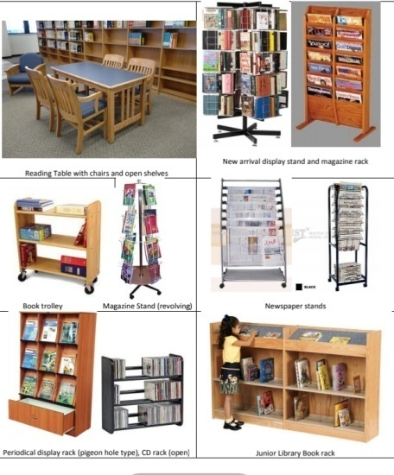
Furniture
a) Chairs: wooden and cushioned
b) Reading tables: round/rectangular wooden tables which can accommodate maximum 4/6 chairs
c) Librarian’s table
d) Circulation counter : designed as per the requirements
e) Book shelves: wooden, open shelves
f) Shelf for keeping library records
g) Book supports: metal/wooden
h) Book trolley
i) Periodical display rack: with pigeon holes to keep back volumes
j) New arrival display stand (rotating/stand alone models)
k) Newspaper stand
l) Bulletin boards
m) Ready reference shelf
n) Computer furniture (carrels)
o) Property counter
p) CD racks: lockable
q) Suggestion box

Slide 16
EQUIPMENTS
a) Computer systems of latest configuration and with adequate power backup facilities: At least 5 in Nos with internet facility. i) One (1) computer for technical processing under library automation and to process library files/documents. ii) One (1) computer for providing OPAC (Online Public Access Catalogue) facility to the users to search the database and, iii) Three (3) computers for providing internet access to users
b) Laser Printer (to carry all printing tasks in the library)
c) Bar-code Printer (for printing bar-code labels)
d) Bar-code Reader (for reading the bar-code labels during circulation)
e) Scanner (for preparing digital documents)
f) External hard drive (for keeping daily back-up)
g) Photocopier (copies of the documents can be provided on payment)
h) Audio systems: head phones to listen audio books, and multimedia C
i) LCD Projector with Interactive board/ LCD Monitor (for demonstrations based on the Information Literacy Curriculum)
j) CCTV (in big libraries)
k) Ceasefire systems (in the stack and reading rooms)

Slide 17
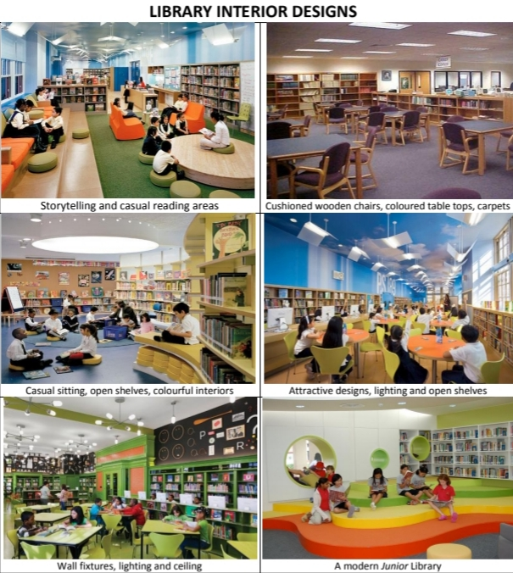
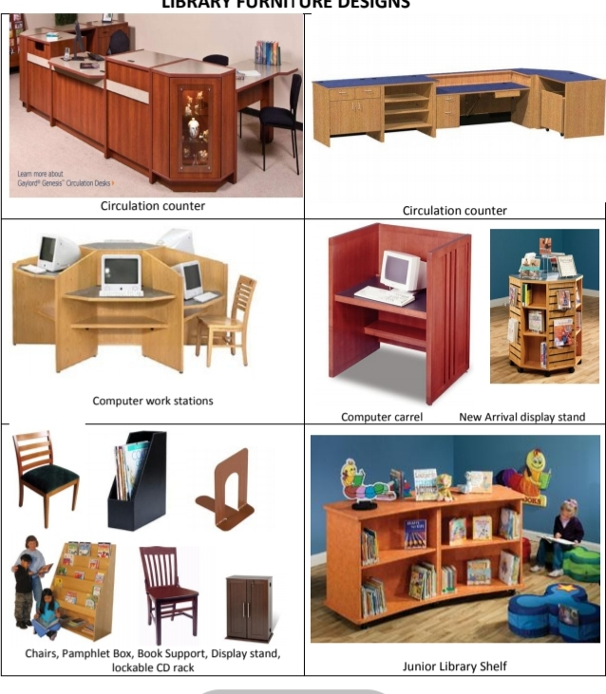

Slide 18
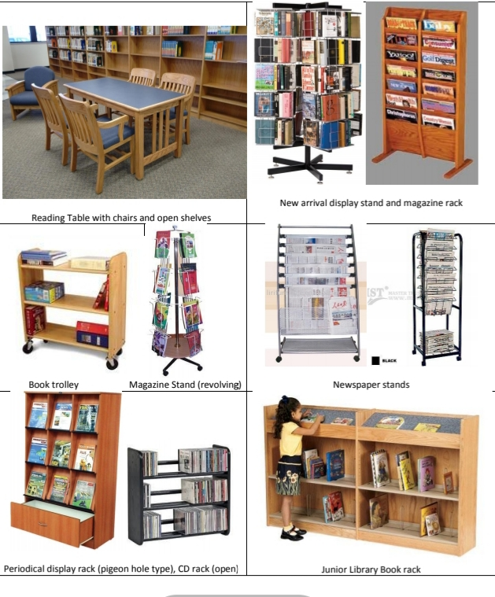

Slide 19

CATEGORIES OF BOOK
Broadly the books can be categorized in the following manner.
I. General book: - The subject matter is discussed in a general manner. The subject may be simple exposition of a specific subject.
II. Textbook:-It is a book of instructions developed for the students of a particular level course for the particular branch of study. Accordingly it provides basic knowledge about a particular subject in an easy and understandable language with colorful presentation and plenty of illustrations.
III. Reference book: - Contains readymade information basically known as compilation and compendium of various disciplines of knowledge. They are not meant for continuous reading rather these are consulted for specific piece of information. The variety of reference books include dictionaries, encyclopedias, yearbooks, almanacs, biographical dictionaries, handbooks, directories, gazetteers, and atlases etc.

Slide 20
Library collections
The school library should provide access to a wide range of resources that meet the needs of the users regarding education, information and personal development. It is imperative that collections continue to be developed on an ongoing basis to ensure that the users have constant choice of new materials.
The nature and scope of core collection of the library should take into account the size of the School and subjects offered besides covering project based activities, career guidance, counseling etc.
Library collections are dynamic resources. There should be constant review and renewal of materials to ensure that the collections are current and relevant to the users/stakeholders.

Slide 21
Library collections
These kinds of materials may be selected in cooperation with the students to ensure that it reflects their interests and culture, without crossing reasonable limits of ethical standards.
A Book/Periodical/Multimedia Selection Sub-Committee would be formed by including the subject teachers as well as student representatives. It is always better to get the books and other reading materials personally examined by Book Selection Sub-Committee members before the purchase.

Slide 22

Besides the core collection, other general books put together should be at the rate of 5 books per student subject to a minimum of 1500 books for newly opened schools.
Multiple copies of popular children’s fiction books would be made available to cater to the needs of the maximum number of users.

Slide 23

A separate collection of publications by KVS, NCERT and CBSE (Curriculums, guidelines, policies, and instructional materials) would also be maintained.
A small and core collection of books of the regional language may be developed for reference in the schools where regional language is opted as a subject.

Slide 24
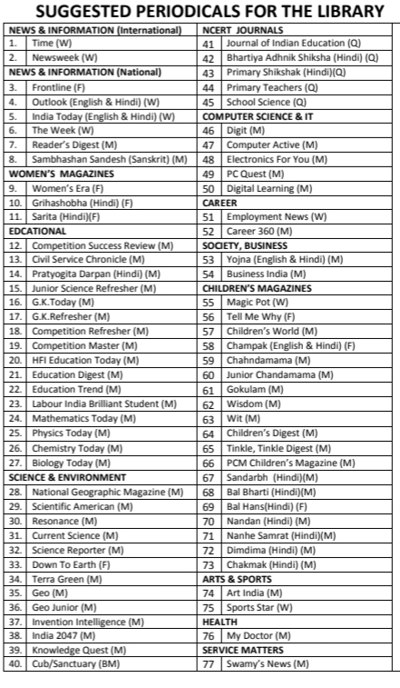

Slide 25
School Library Committee
There shall be a library committee, headed by the Principal and at least 05 teacher members who have a genuine love for books. The teachers should be two from Primary and three from Secondary and Senior Secondary classes (preferably from different subject areas). The committee would also include two student members selected together by the Principal and Librarian from Classes VII to XII. The Librarian would be the Member-Secretary of the Committee.
The School Library Committee should constitute sub-committees for specific functions like ‘Book Selection Sub-Committee’, ‘Stock Verification Sub-Committee’ and ‘Reader’s Club Sub-Committee’.

Slide 26


Library automation
Library automation may be defined as the application of computers to perform some of the traditional library housekeeping activities such as acquisition, circulation, cataloguing, stock verification, serials control, etc.

Slide 27


Software
Many school library software are available for library purpose but one of the best software E-Granthalaya (Version 3.0 or the latest) developed by National Informatics Centre (NIC) is used by the all schools under KendriyaVidyalayaSangathan.

Slide 28
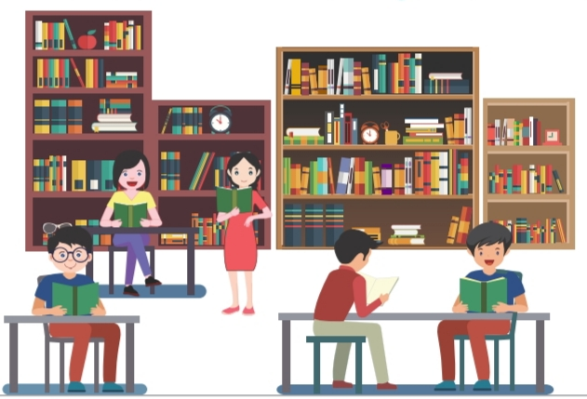
OPEN ACCESS
The library should follow an open access system to provide freedom to choose resources and facilitate its maximum usage. Books should be arranged in open shelves.

Slide 29
ACCESSIONING OF BOOKS
All the books purchased should be checked thoroughly so that books fond damaged are not stamped, accessioned. The library ownership stamp (which contains the name of the Vidyalaya and “Library Media Centre”) should be affixed at the following places in the book.
i. On the back of the title page
ii. At the bottom of the confidential (secret) page; and
iii. At the last page of the book.
All the books accessed should be entered into the accession register. Each copy or volume of the book is entered on the separate line and is given with different or next accession number
Accession number shall be written on the title page, back of the title page, confidential page (page number 51/101) and at the last page.

Slide 30
Classification scheme
Dewey Decimal Classification (DDC) scheme, Edition 22 (or the latest), should be followed for the classification of library books. For guidance, librarians can consult DDC Schedules for School Libraries given in “CBSE: Organizing School Libraries Manual”, DDC in Indian National Bibliography brought out by the Central Reference Library, Kolkata and freely available first three summaries of DDC on OCLC website.

Slide 31
BULLETIN BOARDS
The library should maintain enough number of bulletin boards to inform the users about library resources and activities such as information about new arrivals, library programmes, library statistics, book reviews and to display book jackets, posters, bulletins, etc. There may be separate bulletin boards for Reader’s Club and providing career and guidance information.

Slide 32

Reading Corner
A “Reading Corner” shall be set up in the Primary block where a newspaper and multiple copies of children’s magazines can be kept for open/anytime reading. This will be under the charge of Head Master/Mistress.
“Hanging Libraries” shall be developed for class I-III, where children’s magazines and donated books (voluntarily donated by students, teachers and parents) are clipped and hanged on a thread in the class room.

Slide 33

Stock verification
The primary aim of stock taking is to ascertain if all books that have been accessioned in the library can be accounted for. Stock verification should be conducted annually during the month of March with the help of teachers deputed for the purpose.
For libraries having more than twenty thousand volumes and up to fifty thousand volumes, stock verification should be done at least once in three years. Sample physical verification should be done every year. In case such verification reveals unusual or unreasonable shortages, complete verification shall be done.

Slide 34
WEEDING OUT (WRITING OFF)
The process of withdrawing documents from the shelves for transferring them to storage or discarding it permanently is defined as weeding.
It helps to allow space for new items, ensure easier access to the collection
The criteria for selecting documents for weeding out are,
  i. Physical condition: mutilated, brittle, pest infected
  ii. Duplication: availability of multiple copies of the same documents
  iii. Older outdated editions: text books, study materials based on the old curriculum (one copy may be kept for reference)
  iv. Poor content and use: quality of contents and the documents not in use for a long time.

Slide 35

A list of books to be weeded out/written off shall be prepared and submitted to the Condemnation committee. It shall be convinced about the logic and economics of disposal of these books. Once the approval of the competent authority has been obtained, necessary postings may be made in the Accession Register.

Slide 36
CARE AND MAINTENANCE OF LIBRARY MATERIALS
Key environmental factors which affect the life of library materials are dust/dirt, heat, relative humidity, pests, pollutants, and exposure to light.
i. Integrated Pest Management: Insects and pests such as Silverfish, booklice, firebrat, beetles, termites, rodents, and vermin infest books due to poor housekeeping. A pest management/control programme (fumigation, cleaning, etc) should be carried out in the Library annually or as and when required.
ii. Climate control: Very high humidity encourages mold growth and insect infestations. Low humidity causes materials to lose their flexibility. Generally, the relative humidity in the library should be between 30-50%. The ideal temperature is 18-20 Celsius. The Library may be recommended for air conditioning (AC)
The students and staff members should be given with instructions/guidance on the proper handling of library materials

Slide 37

Library Rules
All students and staff of the school are members of the library.
A student can borrow only two books at a time for a period of two weeks.
A staff member can borrow maximum five books at a time for a period of one month.
Books will be issued to the students, during the library periods.
No book will be issued or returned during the teaching hours.
Marking underlining or writing on library books, periodicals and
newspapers is strictly forbidden.
Reference books and current periodicals will not be issued to any members. These can be consulted only in the library.
If the books are not returned within the specified time it will be viewed seriously and fine will be charged as per rules.

Slide 38

Library Rules
The Librarian may call for a book at any time, even if the normal period of loan has not expired.
In case of book is misused, wrongly handled or lost the person concerned will have to replace the book or pay the current market price of the book.
After reading, make sure that the books, periodicals and newspapers are kept back at their respective places.
The members should take good care of library furnishings and equipment.
Make sure the library looks as good when you leave as it did when you
came in.
Drink and food are not allowed in the library.
Library computers are for academic purpose only. Do not tamper with the computer settings. Follow the internet safety guidelines.
A ‘No Dues Certificate’ by each student is to be obtained from the Librarian while his/her transfer/withdrawal from vidyalaya.
Strict order and silence shall be maintained in the library and speak softly if needed.

Slide 39

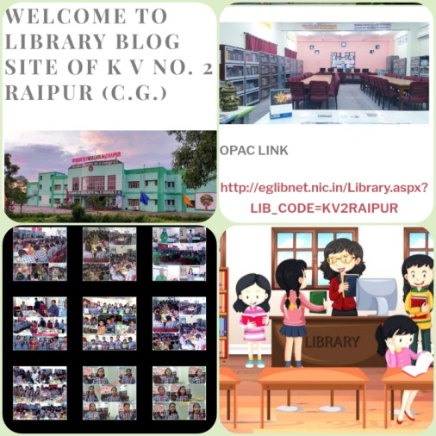
Library Blog
Blog is a handy web 2.0 tool for library professionals, which can act as an information and publicity tool, a feedback instrument, an interactive and collaborative learning medium and a channel for library promotion.
The library shall create its own blog through which it can collect, organize and disseminate online resources useful for students and teachers effectively.
The library blog will act as a digital interface to the library.

Slide 40

Reader’s Club
Developing reading habit and information literacy skills among students and teachers is the primary objective of a school library. A well organised and active Reader’s club helps to achieve this objective.
Librarian shall be the in-charge of the Reader’s Club supported by a committee of students and teachers.

Slide 41

Activities
The Reader’s Club shall develop an annual activity plan with the following suggested activities.
Competitions: Book review writing, reading competition, storytelling, book jacket/book mark designing, literary quiz, spot poetry writing, slogan writing, poster designing, etc
Assembly programmes: weekly book review in the assembly in English and Hindi, enacting the famous characters from a book, etc
Awards: Reader of the Month / Best reader awards

Slide 42
Annual Library Activity Plan (ALAP)
The library should have an annual activity plan.
In the beginning of the academic session, the library committee will chart out the activities/programmes with proposed dates and expected outcome.
The activities can be planned based on the local resources/facilities available.

Slide 43

Library Activities
The school library should cover a wide range of activities and should be a main role player in achieving the mission and vision of the school. It should aim to serve all potential users within the school community and meet the particular needs of different target groups.
Some suggested library activities are given below.
Exhibitions and Displays of books : on important days (Independence Day, Republic Day, Children’s Day, Youth Day, Teacher’s Day, National Education Day, etc),
birth/death anniversaries of important personalities (Gandhi Jayanti, AmbedkarJayanti, etc)

Slide 44
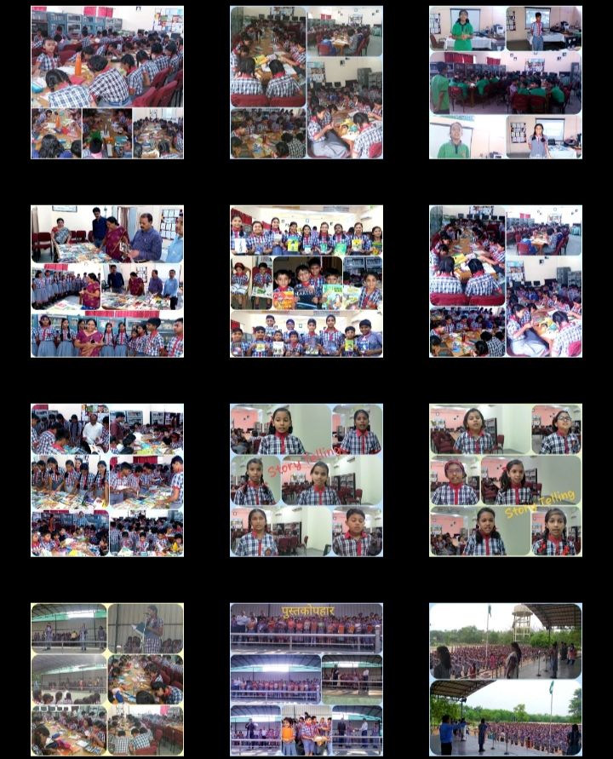

Slide 45

Celebrations: National Library Week, Library Day-Month from 19th June 20 to 18th July 20. World Book and Copyright Day, Librarian’s Day, Reading week, etc
Competitions: Reading, Storytelling, Book review writing, Book jacket designing, Bookmark designing, Book/Literary Quiz, Library lot, Poster designing, Slogan writing, Fastest Book searcher, Smart web searcher, Spot poetry writing, etc
Book Fairs: organized in collaboration with Governmental (NBT/CBT) or external agencies.
Events: Meet the Author, Local Library visits, Book talks, etc
Awards: Best Reader Award, Reader of the Month, Best Book reviewer Award, etc
Publications: Library Bulletins, Library Magazine, Library News Letter, brochures, etc

Slide 46
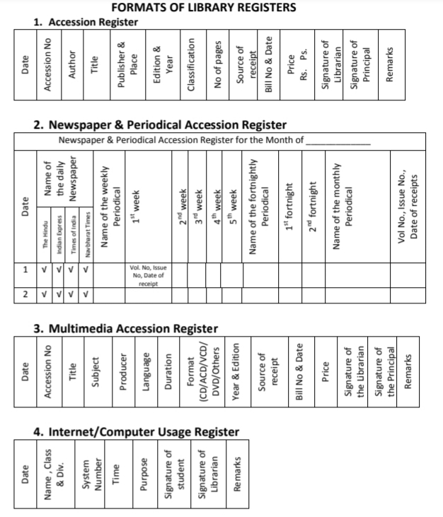
FORMATS OF LIBRARY REGISTERS

Slide 47
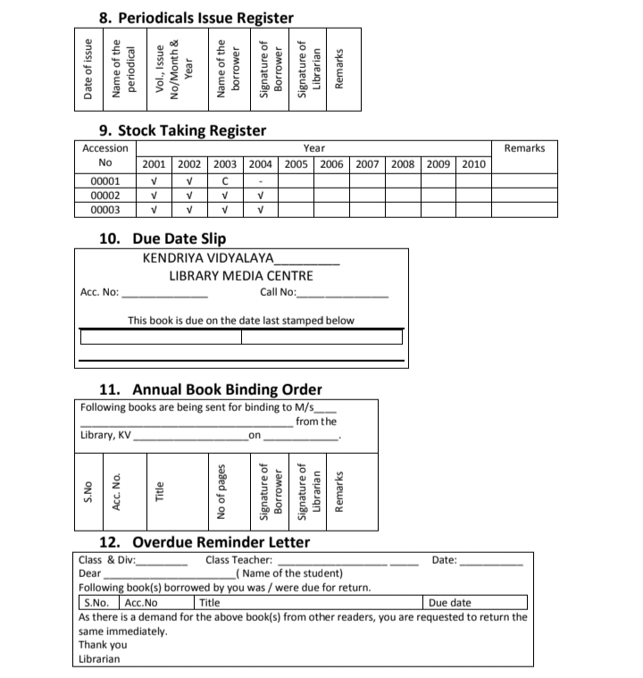

Slide 48
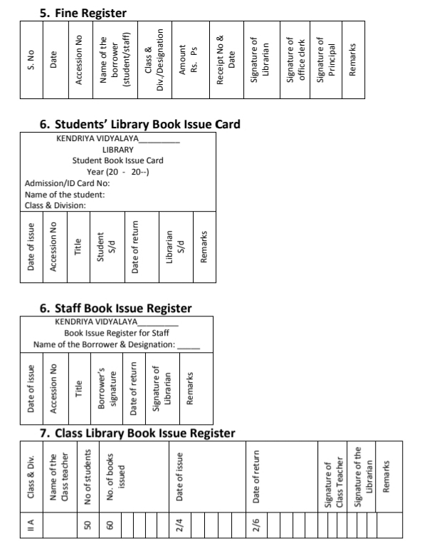

Slide 49



BHOOPENDRA SHRIVASTAVA
LIBRARIAN
K V NO.2 RAIPUR C.G.

